Slide 1
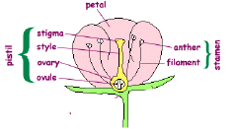
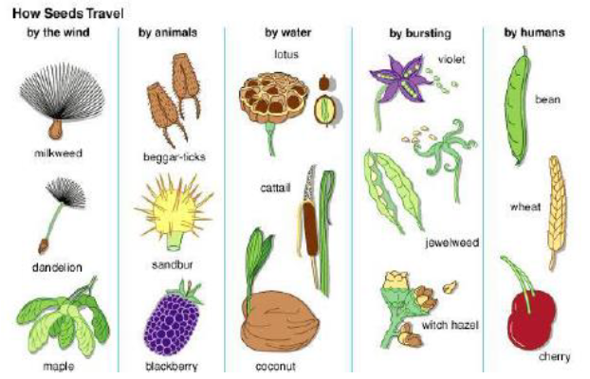
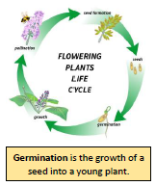
LKS2- Plants
Roots | Anchor the plant in the ground and absorb water and nutrients from the soil.
Stem | Transports water and nutrients to different parts of the plant.
Leaves | The place where photosynthesis takes place.
Petal | The separate leaves that form the outside part of a flower head and usually attract insects.
flower | The part of a plant which allows it to reproduce.
Seed | Produced the fertilisation ovule, seeds allow a plant to reproduce.
Pollen | The product of a male part of a plant which allows it to produce seeds.
Nutrient | A substance that provides nourishment for growth. All living things need nutrition.
Pollination | The process by which pollen is transferred to the female parts of the plant which means the plants can make seeds and reproduce.
Seed dispersal | The movement or transport of seeds away from the parent plant.
Photosynthesis | The process by which green plants use the sun’s energy from sunlight along with water and carbon dioxide to produce their own food in the form of glucose (sugar).
Characteristics of Living Things – MRS NERG/MRS GREN
M | Animals move around, plants grow toward light and their roots grow into the soil.
R | The process of using oxygen to turn food into energy.
S | Living things react to their environment.
G | Food provides energy for plants and animals to live.
R | Removing waste products from the body.
E | Animals have babies & plants grow from seeds.
N | Animals and plants both develop over time.

